Slide 1


Smart-U: Smart Utensils Know What You Eat
Qianyi Huang, Zhice Yang and Qian Zhang
Department of Computer Science and Engineering
Hong Kong University of Science and Technology
Notes:
Thanks for the introduction.
Good afternoon, everyone! Welcome to my presentation. Today I will present our work on smart utensil design to track meal composition.
This is a joint work with Dr. Zhice Yang and my supervisor, Prof. Qian Zhang.

Slide 2
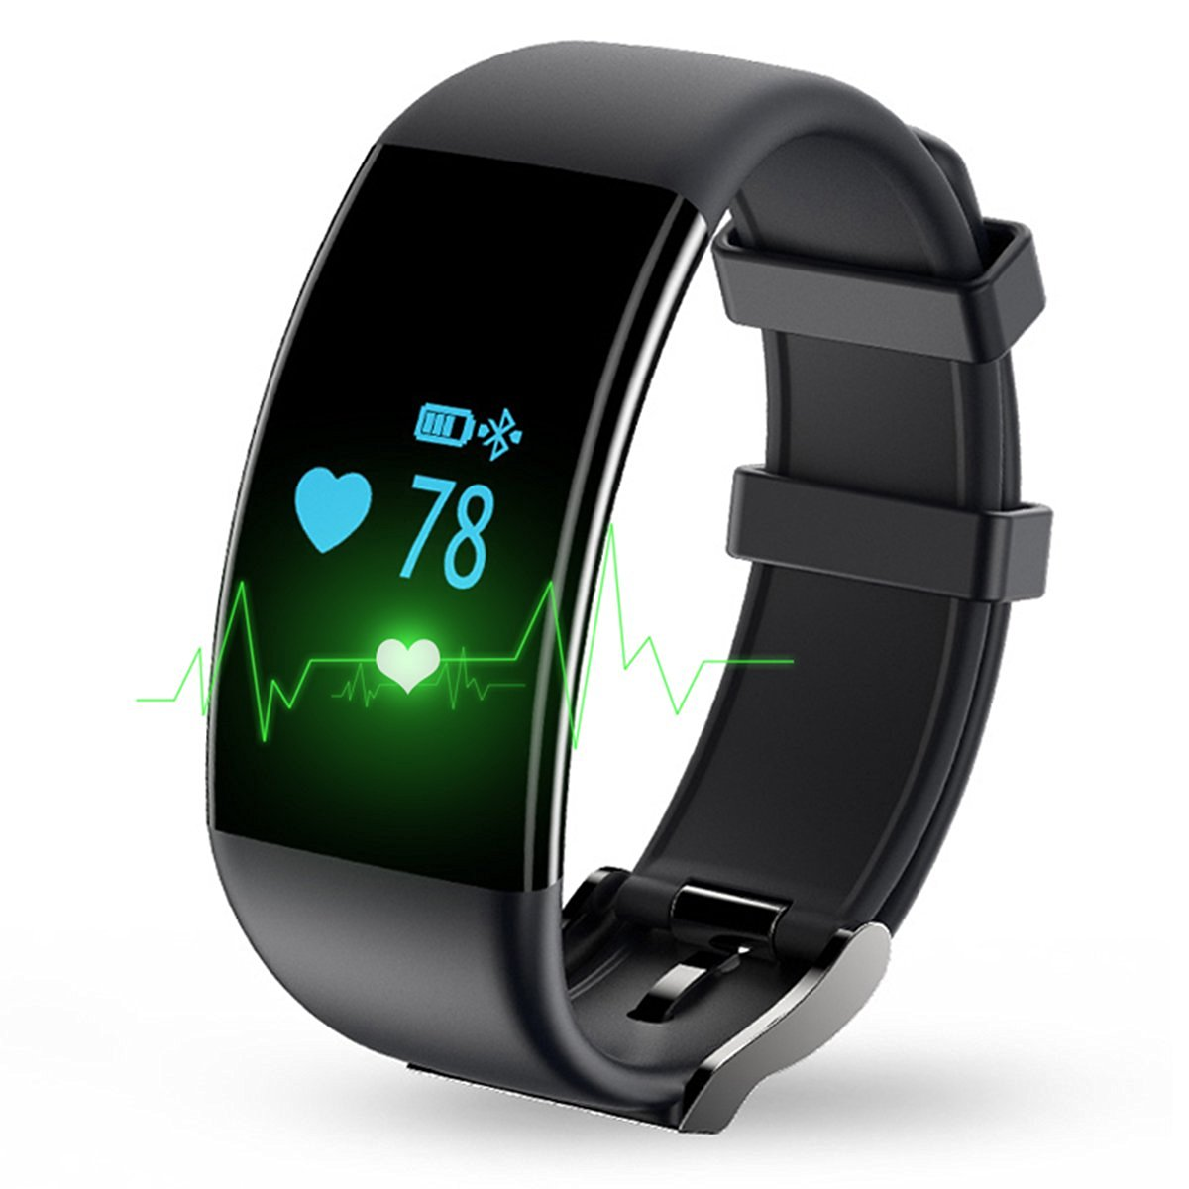

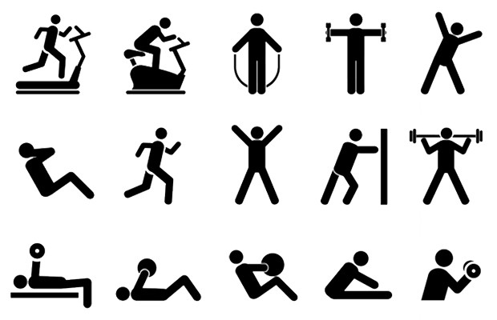
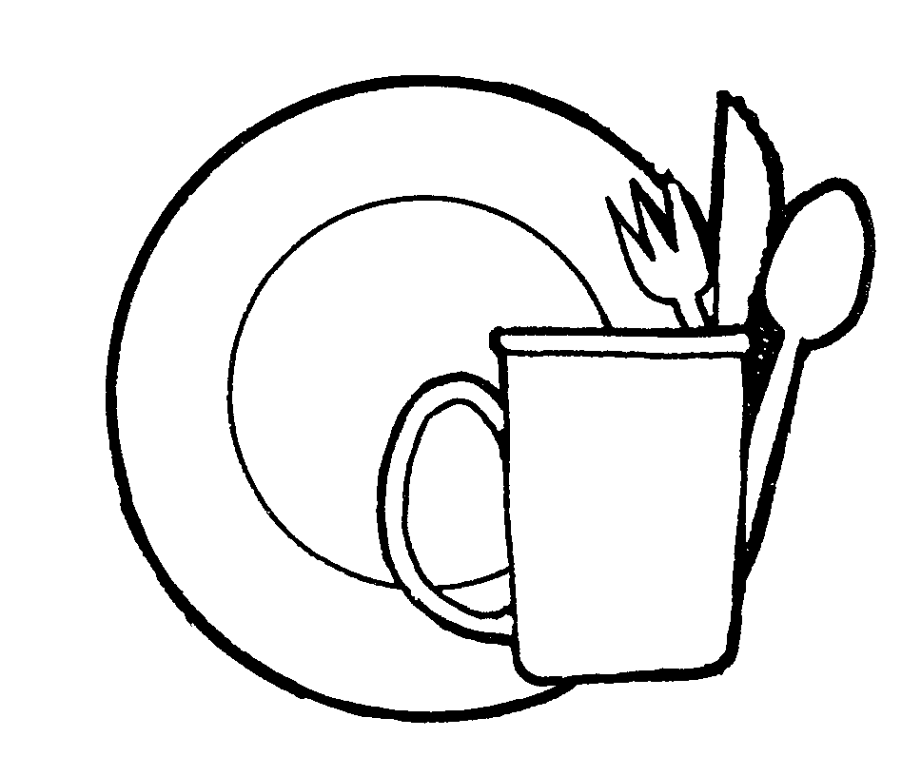
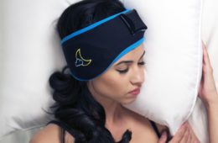

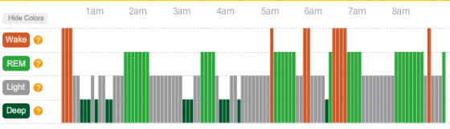
Limited Efforts in Dietary Monitoring
Eat
Sleep
Exercise
Notes:
[Script] Technology has changed the way we manage our health.
Eat, exercise and sleep are the three important dimensions in health-care. For exercise, now we have fitness trackers that can track our activity. It can tell us our exercise intensity and heart rate during exercise. For sleep, there is wearable EEG trackers that can tell us how well we sleep and the ratio in different sleep stages.
However, for eating, there is no satisfactory solution yet. The common practice is to ask the users to manually input what he/she has ate. This is a very tedious process and is often inaccurate.
How to achieve automatic dietary monitoring is also an opening issue in health-care.

Slide 3
Dietary Monitoring
Do my children get
enough nutrients today?
When
How much exercise is needed
to burn the calories I consumed?
How Much
What
Study how chronic diseases are related to dietary habits
Notes:
Dietary monitoring is actually to answer three questions. That is, when do we eat, how much do we eat and what do we eat.
With this dietary information, we can answer questions like “Does my child get enough nutrients today?” or “How much exercise is needed to burn the calories I consumed?” Furthermore, if we can monitor food intake over a long term, it could enable doctors and nutritionists to study how chronic diseases are related to dietary habits and provide food suggestions for the population.
Unfortunately, it is not easy to answer these three questions, especially what the user is eating.

Slide 4
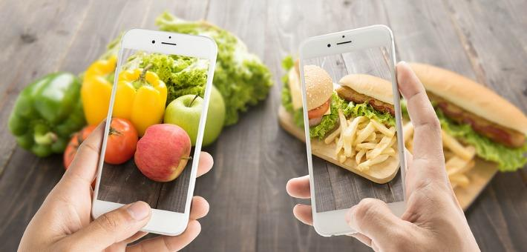
Existing Methods – Computer Vision
Drawback: Cannot handle occlusion; Cannot distinguish food with same appearance
Notes:
Although there are existing methods to address this issue, all of them are limited in some certain way.
The most popular approach is to take a photo of the food before eating. However, computer vision based approach cannot handle occlusion. In this example, it cannot tell what is inside the hamburger. Furthermore, they cannot distinguish food with similar appearance, such as they cannot distinguish between whole
milk or skimmed milk.

Slide 5
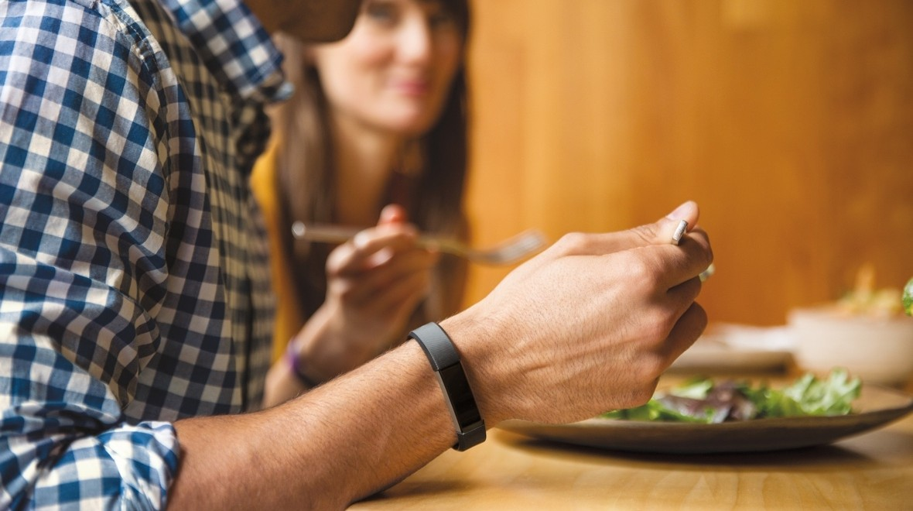
Existing Methods -- Wearables
Drawback: limited capabilities in recognizing meal composition
Notes:
Another way to monitor food intake is to exploit the on-body sensors to track food intake gestures. They typically detect eating-related actions (e.g., stirring and cutting). It could detect general meal types, such as whether the user is having pizza or soup, but it is very hard to provide the detailed meal composition.

Slide 6
Smart-U: Smart Utensils Know What You Eat
Smart-U are utensils with food recognition capability
No on-body instrument
Recognize the foods during the intake process
Can work with many types of utensils, e.g., spoons, glasses, and dishes
Notes:
In this work, we introduce Smart-U, a new method for tracking meal composition. Smart-U are utensils with food recognition capability. Smart-U does not require the users to wear any on-body devices or perform any extra actions. It recognizes what foods are consumed by the users during the intake process. Furthermore, Smart-U can work with many types of utensils, such as spoons, glasses, and dishes. It can recognize both solid and liquid foods.

Slide 7
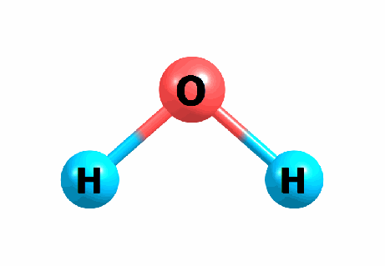

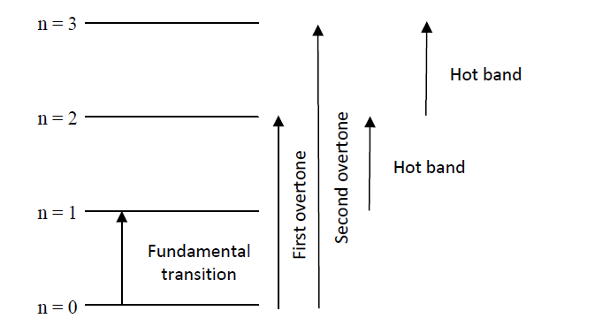
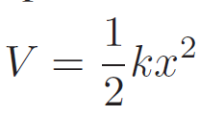
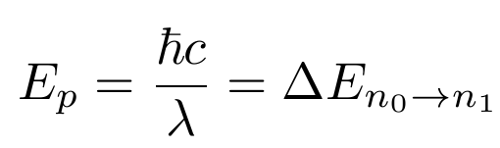
Theory of Operations
Vibration Energy
Notes:
Before introducing the design details, let me briefly introduce the working principle underlying the design of SmartU.
Atoms in a molecular /məˈlekjʊlə(r)/ is connected by chemical bonds. They can be regarded as two masses vibrating on a spring. Its vibration energy is defined as a quadratic function of the displacement from the equilibrium distance. As we know that the energy of the molecular is not continuous. It can be categorized into several discrete levels. When it absorbs energy from outside world, it will transmit among these levels, jumping from one level to another level.
Light can be thought of as a stream of photons. The energy of a photon is inversely proportional to its wavelength. When the energy of the photon matches the differences between two levels, the molecular will absorb the energy and escalate from one level to another level. We can say that the light of this particular wavelength is absorbed by the molecular. Whether the light would be absorbed by the molecular depends both on the wavelength of light and the chemical structure of the molecular. This is the working principle of spectroscopy.

Slide 8
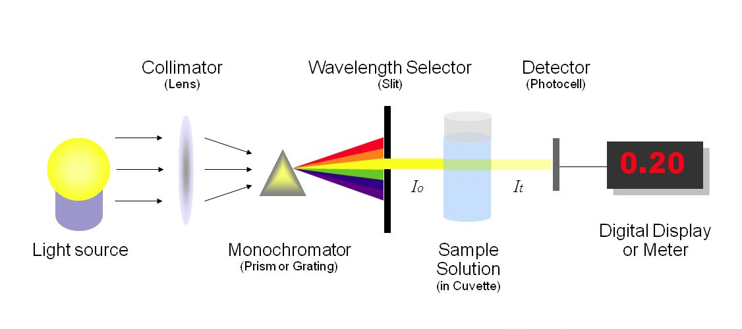
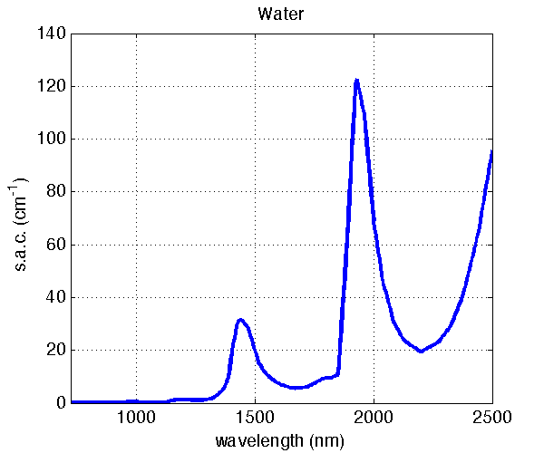
Spectroscopy System
LED Array
Notes:
The big advantage of spectroscopy is that it can analyze food without damaging it.
In a conventional spectroscopy system, the light is dispersed by a grating. After the grating, we use a slit to let only one wavelength of light pass at each time. By either rotating the grating or move the slit, we can let different wavelengths of light pass through the food sample. In this way, we can get a light spectrum. The x-axis is the light wavelength, the y-axis represents how much light is absorbed at this wavelength.
However, the conventional spectroscopy system is usually bulky. It can not be fit into a daily utensil. To make it small, we replace the light source with an LED array. On the LED array, there are a number of LEDs. Each time, we will turn on one LED. By switching over all the LEDs, we can get a discrete light spectrum in this way.

Slide 9
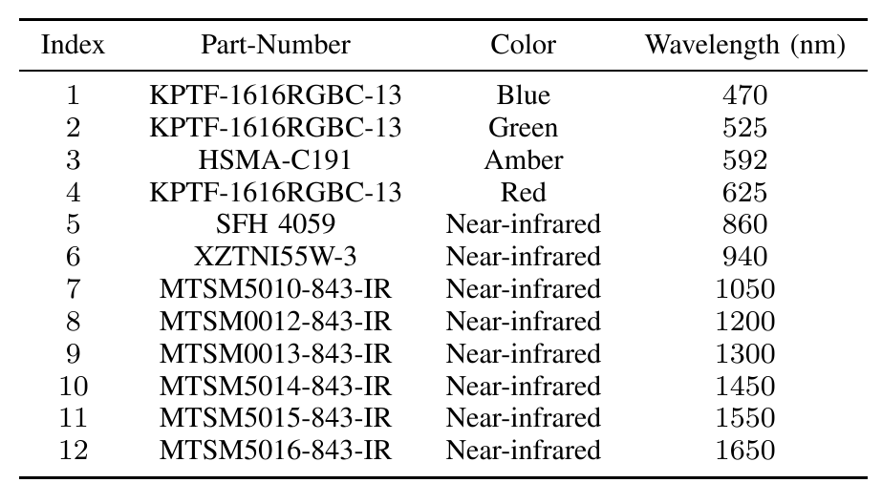
Light Source
1 cm
2 cm
Notes:
Now let me introduce the design details of SmartU.
On a two square centimeter PCB, we place 12 LEDs. We include four visible light LEDs. They are red, blue, green and amber. As many commercial NIR spectrometers cover the wavelength ranging from 900 to 1700 nm, we select 8 off-the-shelf LEDs spreading out in this range.

Slide 10
Lighting Patterns
Change Frequencies
Change Duty Cycles
Notes:
With LED arrays, we can reduce the size of the spectroscopy system. However, we lose a lot of information because we cannot get a complete food spectrum.
As LED light can be modulated by different frequencies and duty cycles, in order to get more information out of the 12 LEDs, for each LED, we will first change its lighting frequencies and then change its duty cycle.

Slide 11
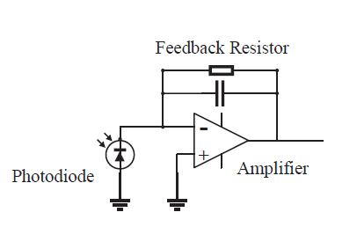
Light Receiver
MCU ADC
Notes:
As for receiver, we use photodiodes. Photodiodes absorb photons and convert light into electrical current. As photodiodes usually produce a tiny amount of current, we need an amplifier circuit to amplify the current so that we can get useful readings. Here we use the photodiode in the unbiased mode, as it is more sensitive
in the unbiased mode than in the reverse biased mode.
The output of the amplifier is connected to the ADC of the Microprocessor.

Slide 12
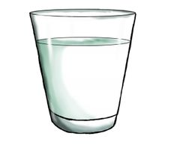
Ambient Light Interference Cancellation
Photodiode
LED
Notes:
Now let me introduce how we recognize food using these hardware components.
When there is food on the utensil, the light intensity received by the photodiodes, indeed comes from four sources. First is the direct path between the LEDs and the photodiode; second is the LED light reflected by the circuit board, surface of the utensils, and other instances (excluding food); third is the ambient light that penetrate through the food and reaches the receiver side; last is the LED light reflected by the food, which is the information that we intend to get.
When we have settled down the hardware components, the first and second components are constant. However, ambient light could be changing and we need to cancel it from the photodiode readings.

Slide 13
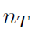
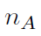
Ambient Light Interference Cancellation
Notes:
To study how ambient light affects foods’ light spectra, we use a Yeelight Bulb from XiaoMi to mimic various lighting conditions. We change the light intensity of bulb from 0 to 100%. We put a slice of beef on the utensil and see how the readings change with ambient light intensity.
We can see that when there is only ambient light, the readings increase almost linearly with the ambient light. When we turn on the LEDs, the readings increase by a certain amount. This is due to the fact that LED light is reflected by the food on the utensil. We denote it by NF. We can see that no matter how the intensity of ambient light changes, NF is almost constant. It means that we can treat the ambient light as background noise. Each time before food recognition, we will first get the intensity of ambient light and then turn on the LEDs and subtract the intensity of ambient light from the photodiode readings.

Slide 14
Food Detection
LED
Photodiode
Notes:
The second step is to detect whether there is food on top of the utensil.
We rely on NIR LEDs and photodiode for food detection. We turn on a NIR LED and continuously tracks how much light is reflected. When there is no food on the utensil, the majority of light emits into the air and little amount is reflected back to the receiver. Thus, the intensity of reflected light is low. As human eyes cannot perceive near infrared light, it will not cause any uncomfortable user experience. When there is food on the utensil, a large portion of emitted light is reflected. Thus, the intensity of reflected light is high.

Slide 15
Food Detection
Notes:
To validate this, we test under three ambient light conditions: indoor environment with no light, indoor environment with fluorescent lights on, and under sunlight. We keep the utensil empty. As we have canceled the interference of ambient light, the reading is rather stable. The values fall within a small range.
We also put 20 types of foods on the utensil and conduct the test under the same environments. In this case, the values spread out over the range and are dependent on the food ingredients.
We further perform t-test on these two sets of data. We get P < 0:001, indicating statistically highly significant difference between the two data sets. Thus, we can set a threshold Tl to discriminate these two cases.

Slide 16
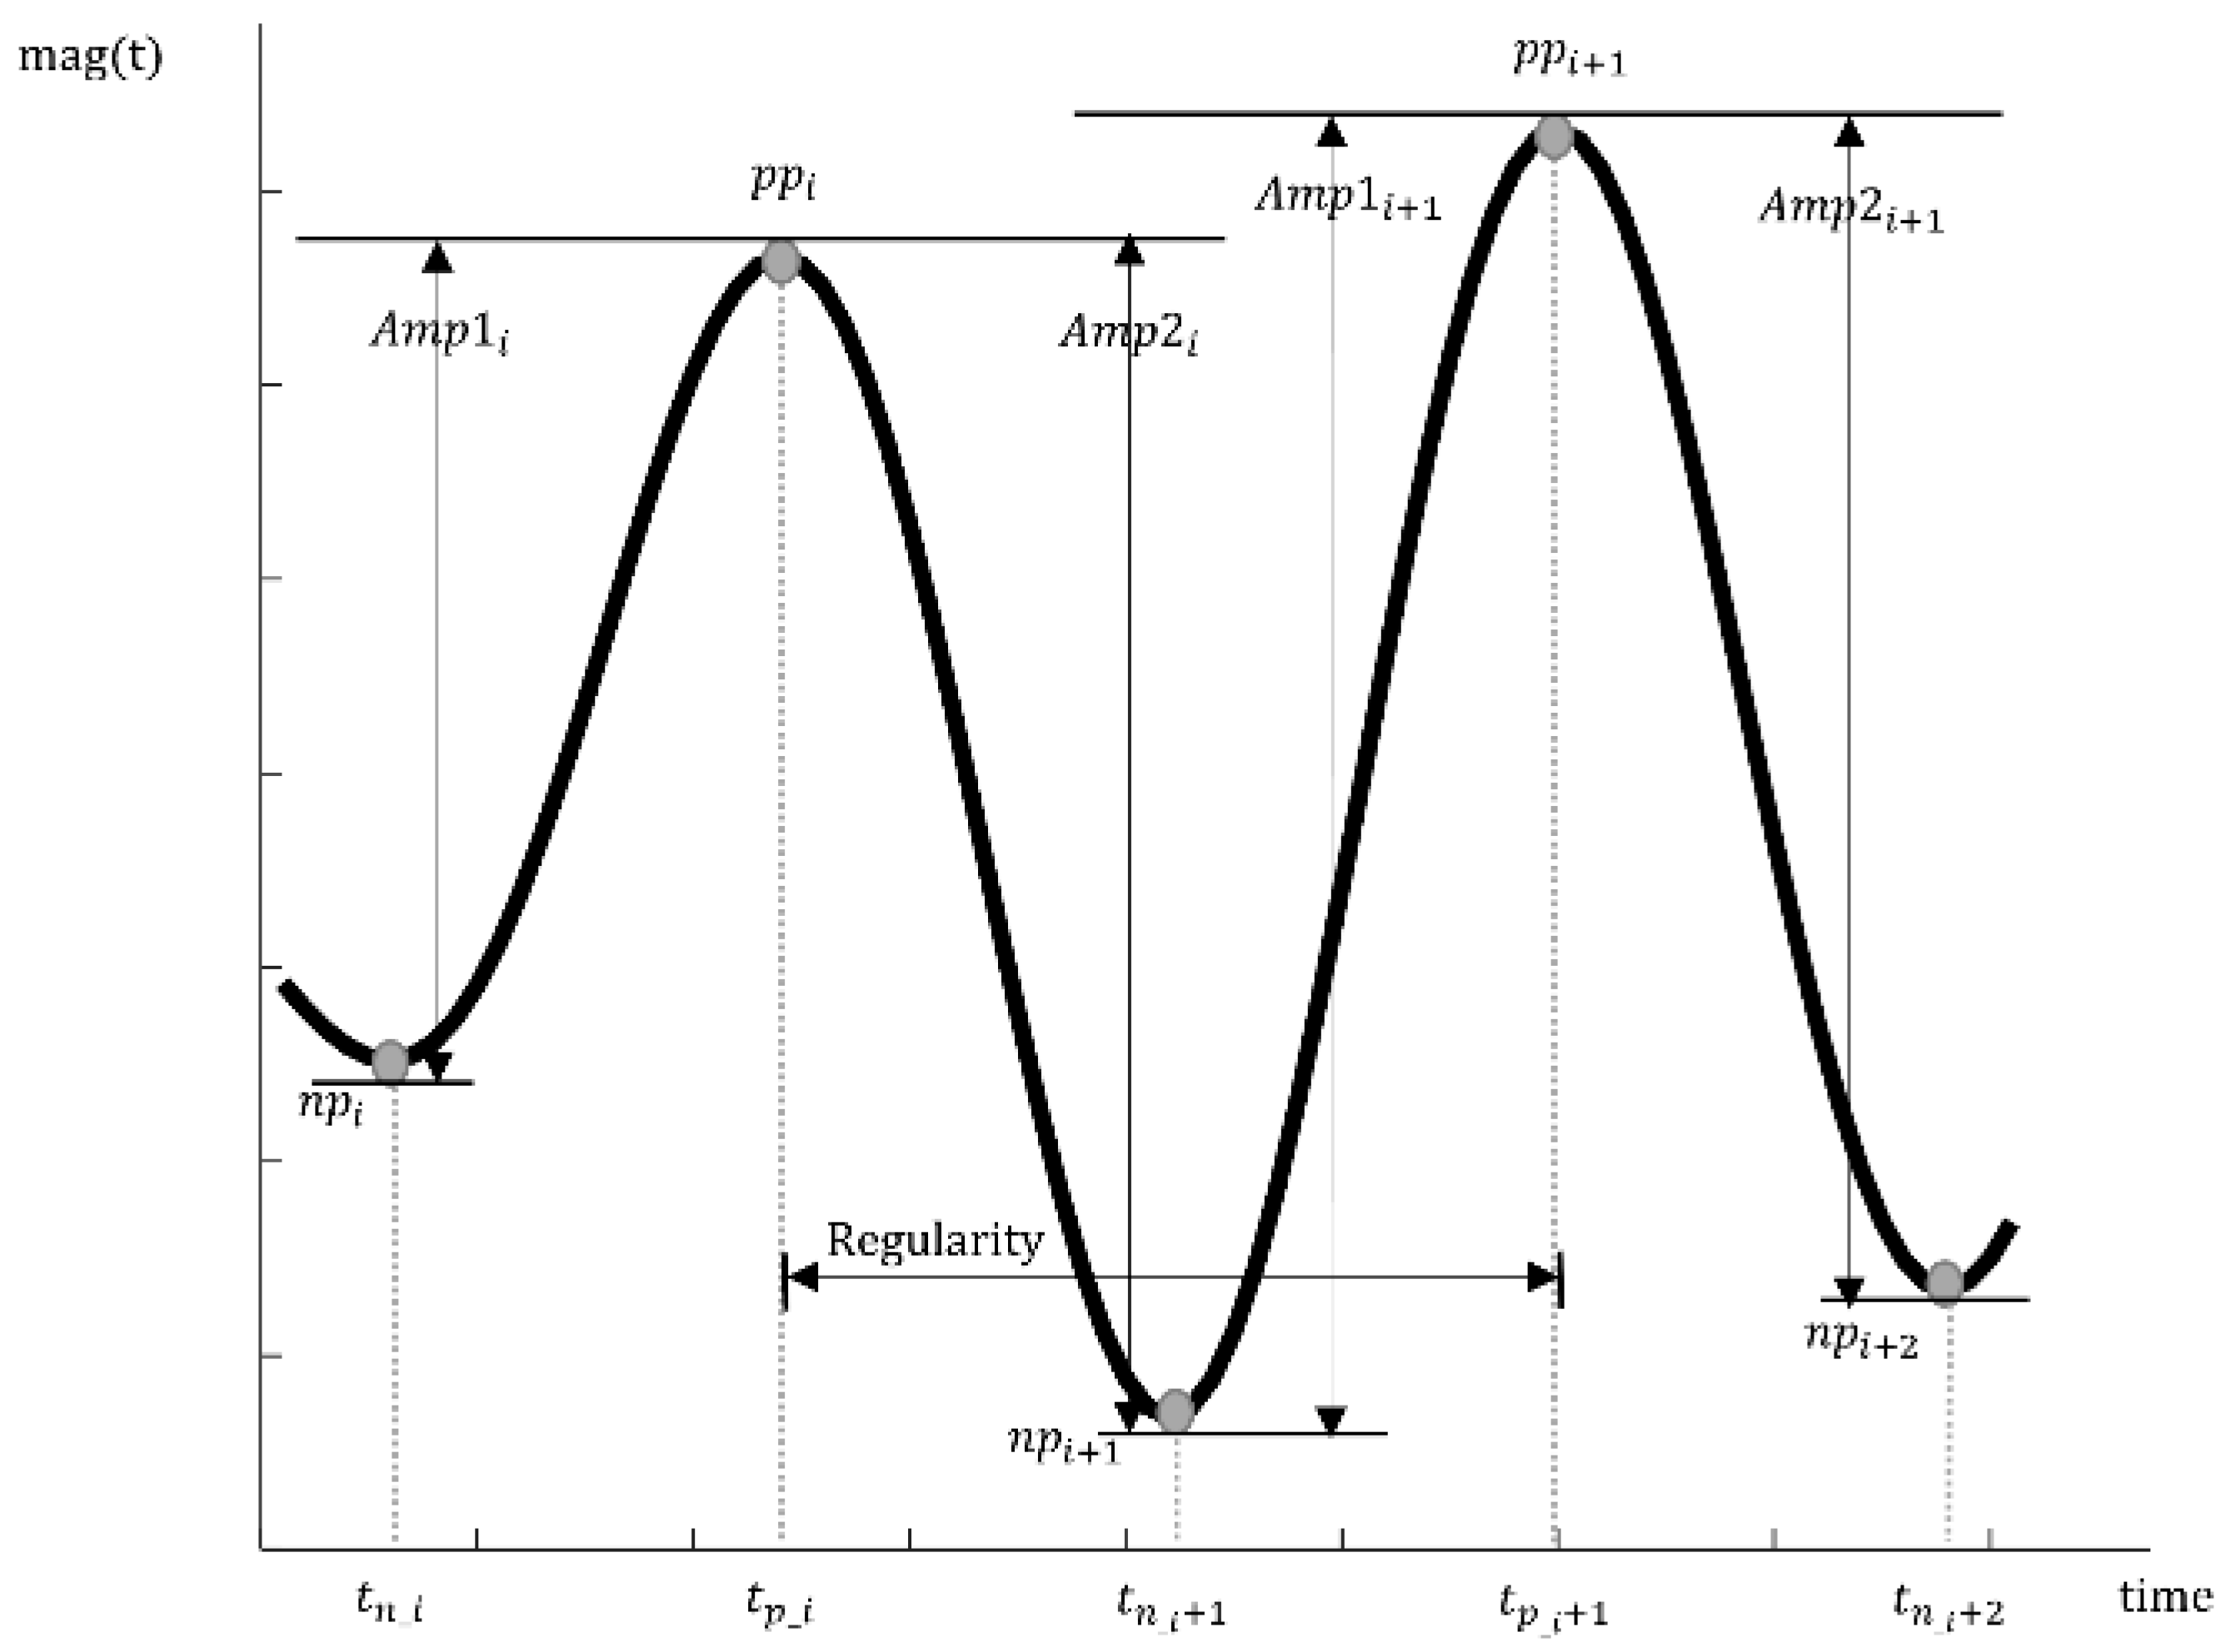
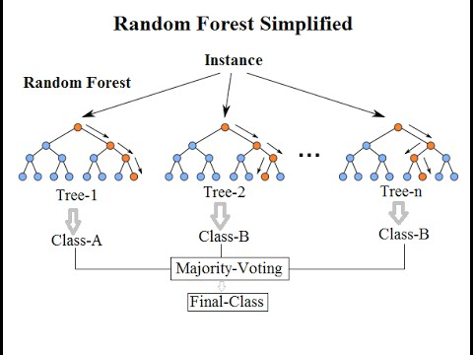
Food Recognition
Food Detection
Without food
With food
LED lighting
Feature Extraction
Food Recognition
Notes:
Here we show the overall processing steps.
The spoon will continuously detect whether there is food on top. When it detects food, it will start turning on the LED one by one. Under every lighting condition, we will extract features and then build Random Forest model for food recognition. We choose Random Forest model because it outperforms other popular classification models in our task.

Slide 17
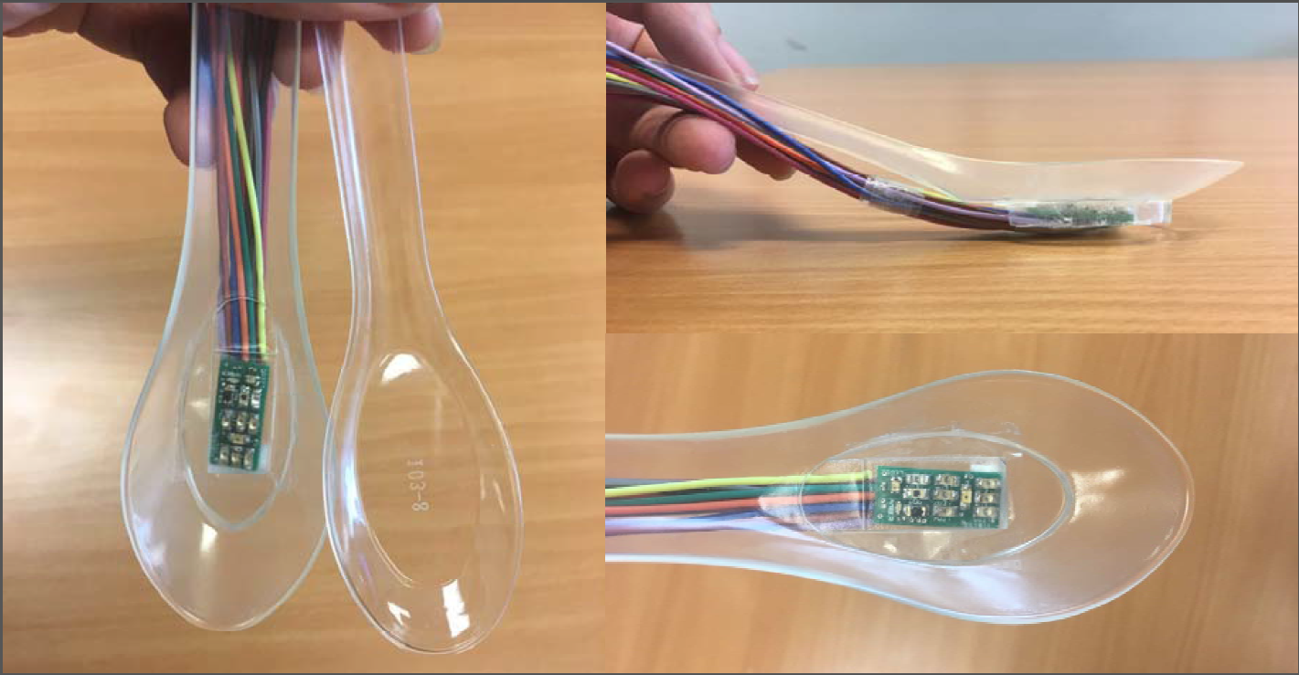
Prototype
2 cm
1 cm
12 LEDs, 4 in visible bands, 8 in near-infrared bands
Notes:
This slide shows the prototype we build. We use 3D print to fabricate a transparent spoon. Its size is close to a normal spoon that we use everyday.
We design a PCB board with 12 LEDs. The total size of the PCB is 2 cm^2. Among the 12 LEDs, 4 are in visible light bands and 8 are in near-infrared bands. We attach the PCB underneath the spoon.
We show the spoon prototype, actually, it is not limited to this. The PCB can be attached to any utensils, such as glass, dishes, etc. We also build a glass prototype by attaching the PCB directly to a transparent glass.

Slide 18
Evaluation
Food Detection
Food Recognition
Performance under various environment
Drink Recognition
Predict Nutrients in Milk
Notes:
Here we give the outline of our evaluation parts. We first show that the prototype we build can detect food very accurately and then show that it can recognize up to 20 types of foods. We also try to predict the nutrients in milk. Then we test the performance of the prototype in various environment and finally, we show the results for recognizing drinks using the glass prototype.

Slide 19
Performance – Food Detection Accuracy
Smart-U has high detection rates and no false positive
Notes:
We do the experiments under four lighting conditions: indoor environment with lights off on a rainy day, indoor environment with a fluorescent light on, indoor environment with an LED lamp on, natural sunlight on a sunny day.
We put the food on the spoon and see whether the prototype can detect the presence of food. We can see that the detection rates are very high.
We also want to see whether Smart-U would give false positives. We put the empty spoon in each environment. During a total duration of two hours, there is no false positive. We also swing our hands over Smart-U to see whether it would trigger false alarms. We notice that only when hands are about 1 cm above the spoon, it will give the false alarm. When hands rise to 2-3cm above the spoon, Smart-U will not trigger false alarms.

Slide 20
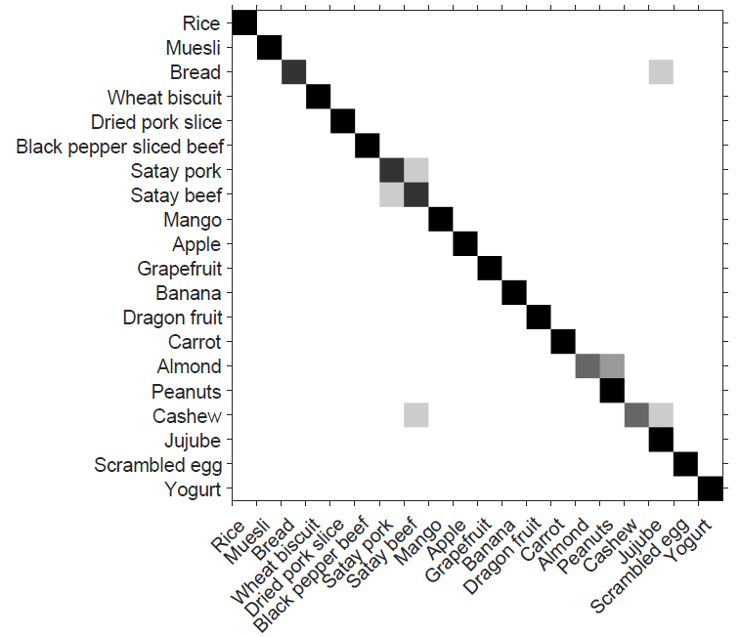
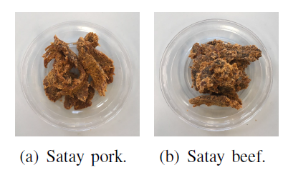
Performance – Food Recognition
Recognizing 20 types of foods with 93% accuracy
Notes:
To test the performance of food recognition, we select 20 types of food according to the Australian Guide to Healthy Eating. It covers the five categories in the food selection guide.
The confusion matrix shows the overall accuracy. The spoon can recognize foods with above 93% accuracy. The confusion comes from very similar food pairs, such as pork and beef. Here we show a picture of the food samples we used in the experiment. They are from the same food category and have a lot of similarities in both appearance and nutrition.

Slide 21
Performance – Lighting and Temperature
Light Conditions
Temperature
Smart-U performs reliably under various lighting conditions, temperature, and with movement
Notes:
We also test the performance under different lighting conditions and different room/food temperatures. Results show that its performance is robust across different testing conditions.

Slide 22
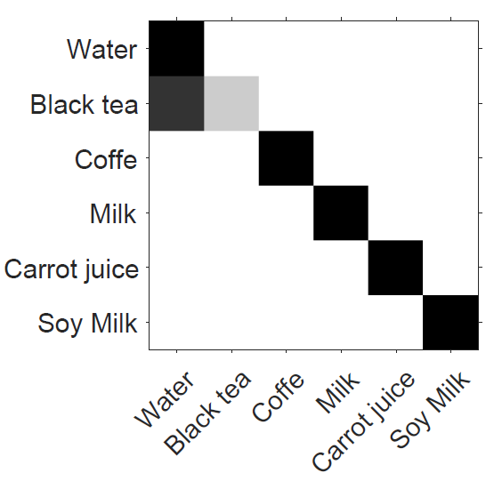
Performance – Drink Recognition
Notes:
Finally, we show the performance to recognize drinks. We prepare 6 types of drinks. All the drinks are correctly classified except that some samples of tea are confused with water. This is because that we prepare the tea samples using a tea bag. As time goes on, the concentration of tea becomes lower and lower and finally, it is confused with water.

Slide 23
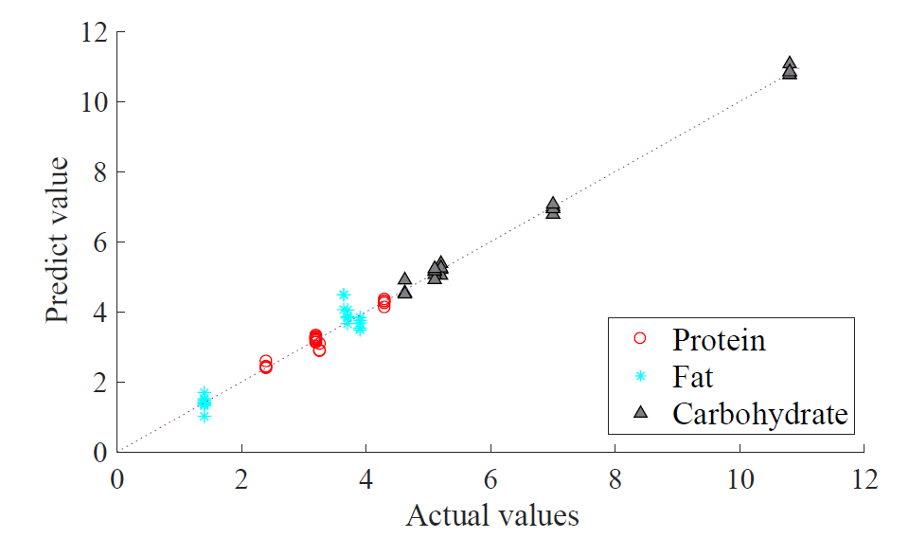
Performance – Predict Nutrients in Milk
High correlation with true values
Protein: 2.7% Carbohydrate:1.6% Fat:8.2%
Notes:
We also try to go further to look at the nutrition facts in milk.
We buy five types of milk from a local supermarket and read their nutrition information from food package. We build a regression model to predict protein, fat and carbohydrate /,kɑrbo'haɪdret/ concentration in the milk.
The predicted value show high correlation with the ground truth. The error for protein and carbohydrate is less than 3% while the error for fat is about 8%.

Slide 24
Discussion
Food amount estimation
Rough estimation based on food detection accuracy
Could incorporate motion sensors to track food serving motion
Safety and life time of Smart-U
Use safe and transparent material
Waterproof, e.g., Liftware Steady, HAPIfork
Notes:
Last, I want to discuss some remaining issues.
This paper mainly discuss how to recognize meal composition. We did not discuss how to estimate food amount. We note that there are two possible ways that Smart-U can be enhanced to estimate food amount. First, as Smart-U can detect whether there is food on top of the utensil, it will detect interleaving positive and negative
results during the meal consumption. In the case of our spoon prototype, Smart-U can infer the number of spoon servings, which is directly related to the amount of food consumed. If Smart-U wants to be more accurate, the second approach it can take is to integrate some additional sensors. For example, it can include 3-axis accelerometer or gyroscope to track the food serving motion.
As for utensils, we may be concerned about whether Smart-U is safe. We require that the bottom of the utensil to be transparent. Nowadays there are many transparent and secure materials. They can be used to build the utensil prototype. As for waterproof, some utensils on the market can be washed under the water. SmartU can use the similar techniques to make it waterproof and durable.

Slide 25
Conclusion
We design, implement and evaluate Smart-U, a new method for recognizing meal composition.
No on-body instrument; can work with many types of utensils, e.g., spoons, glasses, and dishes
Smart-U can identify 20 types of foods with 93% accuracy. We also take the primarily attempt to predict nutrients in milk. Smart-U can work robustly under different conditions.

Slide 26
Thank You!!
Q & A

